Slide 1
CS422 Database systems
Compression & Privacy
Data-Intensive Applications and Systems (DIAS) Laboratory École Polytechnique Fédérale de Lausanne

Slide 2
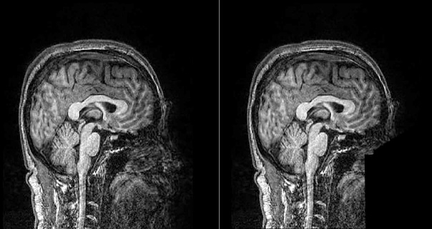

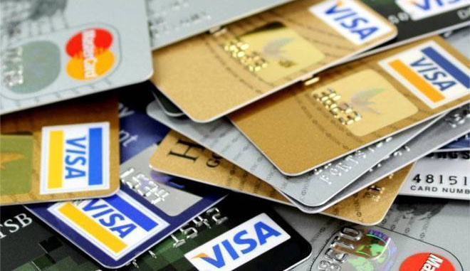

The growth of sensitive data
Data volume and variety is growing
Some types of data are “sensitive”
Notes:
As we have mentioned multiple times already, data is growing both in volume and variety.
Internet-of-Things, mobile applications and digitalization have resulted in a huge volume of personalized information for billions of people. Typical examples include, but are not limited to, medical data, financial portfolios or even their geo-location. This type of personalized information is expected to grow even further in the near future with the growth of biotechnologies, like whole genome sequencing.
There is an interesting property that characterizes all these data: people want to share them, because this will improve their life, but they are not sure about the rules: who should get access, to which part of the data and under which circumstances.
For example, we do not want the insurance companies to have access to our genomic data. Also, most people would disagree to share their location 24/7 either publicly or with companies.
We commonly refer to these types of data, as sensitive data, because we have to avoid disclosing the corresponding information to anyone. This constraint is sometimes ethical but in some cases the obligation is also legal.

Slide 3
To share or not to share?
We need to protect sensitive data
Information sharing is valuable
Enterprise co-operation
Research
…
Privacy
Sharing
Share as long as privacy is ensured
Privacy-preserving data management
Notes:
As we already discussed, we are obliged to protect sensitive data (typically related to people) and we have to manage it efficiently, while avoiding disclosures.
However, sensitive data is very valuable and many actors would benefit if it were accessible. For example, medical researchers and biologists could advance their respective fields by analyzing genomes of different people or MRI scans. Also, several corporations and organizations would benefit significantly from limited information exchange, for example different agencies of the same state that hold separate record repositories.
So here we have a tradeoff. Protecting the privacy of people by protecting their sensitive data against the benefits of information sharing across the different data owners. Still, there is a middle ground. We can share some information, some statistics over the dataset for instance, without compromising the privacy of the people involved or with guarantees about the risk to privacy. To address this opportunity, a whole area of privacy-preserving techniques has emerged in general and in the domain of data management in particular.

Slide 4


A small note: security is not privacy
Security who accesses information
Privacy what information to release
Related areas but different objectives
Security protects from direct disclosure
Notes:
Before we start our dive into privacy-preserving techniques in databases, let’s briefly emphasize on an important detail. Security and Privacy, while related, are not the same thing, especially in the context of databases
Security focuses on access control and authentication. Different users of the DBMSs have different security clearances and can access different tables and functionality. So, it’s a question of who can access each part of the database. Of course, in a secure database, only certain users can access the data.
On the other hand, we have privacy. For our context, it’s about the kind of information that we can release without compromising privacy.
Of course they are correlated. But while security protects from direct data disclosure to unauthorized users, questions such as the inference of higher classified information with privacy attacks are not addressed.
EXAMPLE

Slide 5
Security vs Privacy
BANK
Security
Privacy
tellers can access bank account details –
customers cannot spy on other customers
yearly statistics leak specific customer’s credit status
You can have security without privacy,
but you can’t have privacy without security.
Notes:
To better understand this distinction, we provide the example of a bank
on the one hand, there is the issue of security. The bank stores all the data related to your account in a database and not everyone is authorized to access all the data in this database, even if they have partial access. For example, tellers working for the bank can access the account details of a customer that visits their branch, asking for a service. On the other hand, a customer can access their own data but cannot access another customer’s bank account details from an e–banking application. This authorization scheme is part of the database’s security.
on the other hand, we have privacy. Some banks might be issuing reports with statistics on the credit status of different groups of customers. Suppose that these statistics are per branch and per age group. Then, for a remote area with only one person person under 20, a person reading the report could infer the customer’s credit status. The reader learns more than they should. So, the bank did a poor job deciding what kind of data to publish.
Now, we see in the second case, the system can be totally secure from an authorization viewpoint, but information can be inferred anyway. Of course, if a hacker breaks into the bank’s system, the data is disclosed directly and privacy is lost

Slide 6
Privacy-preserving data management
Operations across private databases
Data Perturbation
k-Anonymity
Differential Privacy
Notes:
We will discuss different types of privacy.

Slide 7
Privacy-preserving data management
Operations across private databases
Data Perturbation
k-Anonymity
Differential Privacy
Notes:
R. Agrawal, A. Evfimievski, and R. Srikant. Information sharing across private databases. In SIGMOD, 2003.
https://dl.acm.org/citation.cfm?id=872771
Literature on information integration across databases tacitly assumes that the data in each database can be revealed to the other databases. However, there is an increasing need for sharing information across autonomous entities in such a way that no information apart from the answer to the query is revealed. This paper formalizes the notion of minimal information sharing across private databases, and develops protocols for intersection, equijoin, intersection size, and equijoin size. It also shows how new applications can be built using the proposed protocols.
(probably the cleanest abstract I’ve ever seen in a paper)

Slide 8



Information sharing across private DBs
Example:
The police checks for fugitive passengers
The police should not know all passengers
The company should not know fugitives
Other actors should learn neither list
Q
?
?
Multiple actors, multiple private DBs
Share information relevant to operation
Avoid disclosing any other information
No trusted third-parties
Notes:
The first technique that we will examine enables data sharing across different DBs while keeping the information disclosed to each participant of the shared operation to the absolute necessary and excludes third-parties.
For example: Let’s suppose that we have an international flight and the police wants to make sure that there are no fugitives travelling abroad.
There are two straightforward ways to ensure this:
The police gets the full list with all the passengers of the flight → privacy violation for the non-fugitives
The airline company gets the full list with all the fugitives out there → privacy violation for the fugitives
Therefore, we need to compute the intersection of the two lists, and reveal the result only to the police, while sharing no other data.
In general: We have multiple data owners participating in query execution, each with their own private database. We want to disclose only the data involved in the result. And we want to do this in a peer to peer way to avoid having the assumption of some third-party who will handle the query execution.

Slide 9

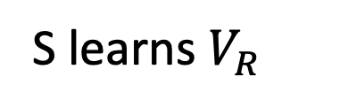
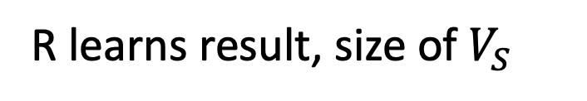


Model: minimal sharing
🤝
$$V_{R}$$
$$V_{S}$$
R learns result, size of $V_{S}$
S learns $V_{R}$
Co-operatively evaluate query across DBs
Enforce privacy with protocols
Reveal query result + delta (e.g. cardinalities)
We will see the example of an intersection
Notes:
In practice, the ideal scenario, in which only the result is disclosed, is not easy to achieve.
For example, we can have a case where 2 data owners agree to share information in order to perform a binary operation. One such example is R learning intersection we mentioned earlier. Actor R on the left-hand side has a private database Vr and actor S has a private database Vs. Now in order to compute the intersection, even if there are careful, some information might leak. R and S might learn how many records the private database of the other person consists of.
So we actually revise our model for minimal sharing, in which the desired operation is performed in a peer-to-peer way. We expect that there will be some extra information exchange other than the ideal which is the query result. To guarantee the privacy and correctness of the procedure followed we use a protocol based on encryption. The end result will be the disclosure of the result to the actor requesting it as well as the disclosure of some categories of information such as metadata for the tables.
To stick with the example we already explained, we’ll discuss a protocol for computing the intersection of two tables, in order to explain the basic concepts for securing privacy.

Slide 10
A note on commutative encryption
Apply encryption functions at any order
End-result will be the same
Cornerstone of the protocols
R encrypts
S encrypts
same output
S encrypts
R encrypts
Notes:
The protocol which enables minimal information sharing is based on commutative cryptographic functions.
Before going to the actual protocol, let’s first take a look at the functionality that these functions provide through an example.
First of all, commutativity is the property that we know from math, which allows us to perform multiple operations at different order, while getting the same result. Accordingly, in commutative encryption, with N parties involved each one with their own key, the result is always the same regardless the encryption sequence.
For instance, suppose that there are two actors, R and S, as shown on the slide. Each one has their own key and they want to encrypt the same packet. In the first case (up), R encrypts first and S second. In the second case, it’s first S and then R.
In both cases, the result is exactly the same considering a commutative encryption scheme.
Note from wikipedia [https://en.wikipedia.org/wiki/Three-pass_protocol]:
“A commutative encryption is an encryption that is order-independent, i.e. it satisfies E(a,E(b,m))=E(b,E(a,m)) for all encryption keys a and b and all messages m. Commutative encryptions satisfy D(d,E(k,E(e,m))) = D(d,E(e,E(k,m))) = E(k,m).”

Slide 11

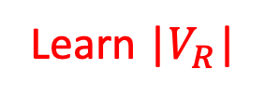
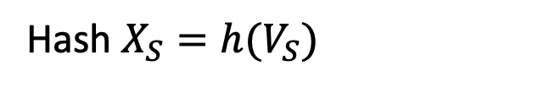
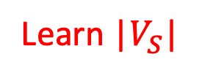
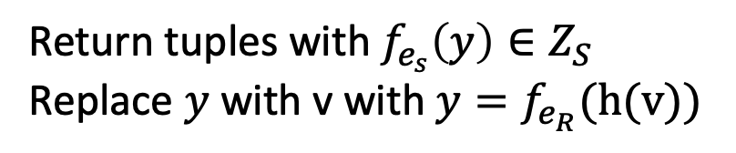
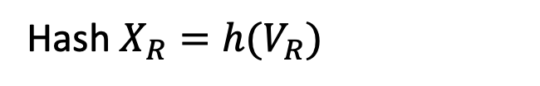
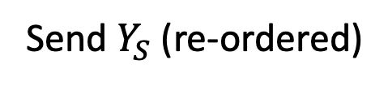


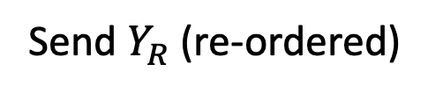


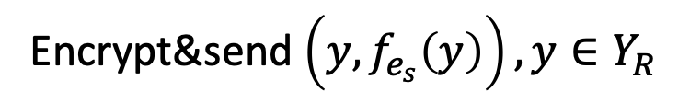
Intersection protocol
Values appear random
Important for security
$$V_{R}$$
$$V_{S}$$
Hash $X_{R}=h(V_{R})$
Hash $X_{S}=h(V_{S})$
Encrypt $Y_{R}=f_{e_{R}}(X_{R})$
Encrypt $Y_{S}=f_{e_{s}}(X_{S})$
Send $Y_{R}$ (re-ordered)
Send $Y_{S}$ (re-ordered)
Learn |$V_{S}$|
Learn |$V_{R}$|
Encrypt $Z_{S}=f_{e_{R}}\left(Y_{S}\right)$
Encrypt&send $\left(y, f_{e_{s}}\left(y\right)\right), y∈Y_{R}$
Values only matched, never decrypted
Return tuples with $f_{e_{s}}\left(y\right)∈Z_{S}$
Replace $y$ with v with $y=f_{e_{R}}(h(v))$
Intersection result
Notes:
Going back to the example with the airplane, we want to execute the query which gives the intersection of two databases without revealing unnecessary information. The intuition behind the approach that I will describe you is the following: Since we are interested only in the intersection, then all we need to do is to make sure: (1) that we will be able to match the data that are the same in both databases, and, (2) that we will be able to retrieve the matched data in their original format (aka they can be decrypted by the actor who performed the query –in our case, the police).
This slide shows the protocol that enables privacy-preserving execution of queries that require the intersection of two databases.
Suppose that these databases belong to actors R and S and that R executes the query (R is the police, S is the airline company). The protocol consists of the following steps:
1. R and S calculate the hash of their databases. With proper hashing, the records will appear random in the domain of the encryption function and therefore have the properties for proving the security of the algorithm. Otherwise, correlations and other properties could be used to crack encrypted data.
2. R and S (a) encrypt their own hashed data with their own encryption key, record-by-record, (b) re-order the data in order to avoid attacks based on the ordering of the data, and, (c) send the encrypted data to their peer. At this point, each participant learns the cardinality of the other table.
3-R. R uses its own key to encrypt each record from the encrypted data received from S, and gets the data records of S after two steps of encryption.
3-S. S uses its own key to encrypt each record from the encrypted data received from R, and create pairs of the value that has been encrypted with R’s key and the same value after encrypting it with both keys. Then, S sends all the pairs back to R.
Note: From this list of pairs, R will be able to decrypt the part that it sent (i.e. the first element of each pair).
4. R has two sets: the first contains all the elements of S and the second all the elements of R. Both sets are encrypted with the keys of R and S. Therefore, the intersection of these two sets is the intersection of the two databases.
5. R retrieves the original records from the database through the association between the records encrypted only with R and the records encrypted with both R and S.
Note, that for the values that do not match across the two datasets, R cannot tell anything because they cannot decrypt it. It is the same for the data that S received. And normally, in crypto brute-forcing the decryption is not practical. So the intersection and the cardinalities is the only information disclosed.

Slide 12
Takeaway: Queries across private DBs
Guarantees limited disclosure
Different protocol per operation (join, etc)
Requires honest actors
Inference from consecutive queries
Heterogeneity and data integration
Notes:
The protocol we saw belongs to a broader family of protocols that give guarantees of limited disclosure. Other similar protocols exist for operations such as equi-joins.
Now some drawbacks are that the actors are honest, for example they don’t hide data or introduce fake data to see if their peer has that data or not.
Also, consecutive queries might prove capable of exposing significant amount of information.
A practical problem is how to identify private DBs with which we can share data and how to bring data to a common format that allows matching.
And finally, a conceptual problem is that this mechanism requires the participation of the data owner in each operation.

Slide 13
Privacy-preserving data management
Operations across private databases
Data Perturbation
k-Anonymity
Differential Privacy
Notes:
R. Agrawal, R. Srikant, and D. Thomas. Privacy preserving OLAP. In
SIGMOD, pages 251–262, 2005.
https://dl.acm.org/citation.cfm?id=1066187
The next technique we will look into is about randomizing the data, perturbing as we say, and then publish it.
This paper presents techniques for privacy-preserving computation of multi-dimensional aggregates on data partitioned across multiple clients. Data from different clients is perturbed (randomized) in order to preserve privacy before it is integrated at the server. We develop formal notions of privacy obtained from data perturbation and show that our perturbation provides guarantees against privacy breaches. We develop and analyze algorithms for reconstructing counts of sub-cubes over perturbed data. We also evaluate the tradeoff between privacy guarantees and reconstruction accuracy and show the practicality of our approach.

Slide 14
Randomized databases
Publish data after introducing noise
Randomization protects privacy
Records not factual, adversary cannot suppress noise
Options: additive noise (e.g. Gaussian), swap across rows, retention-replacement
id | salary
123 | 10500
151 | 3800
199 | 6900
103 | 5400
Perturbation
Algorithm
id | salary
187 | 10500
151 | 7500
133 | 6900
123 | 4000
focus on retention-replacement perturbations
Notes:
Here the idea is quite simple: We publish the data for use but only after introducing some noise. Noise can be introduced in different ways, such as replacing an attribute’s value with a new random value, a value coming from another row or adding noise to the original value as a delta. On the slide, we present an example, where random values are highlighted red.
The way we do it is dictated by a so-called perturbation algorithm.
Accordingly, the way we handle the data from this point on, depends on the perturbation.
Nevertheless, this randomization procedure will protect the privacy of stakeholders, because the published attributes have been randomized and therefore an adversary does not know if a record is correct or randomized.
Now, for the purpose of this class, we will focus on retention-replacement perturbations which is one of the options available.
OTHER OPTIONS
Additive noise, discretization, and other schemes in related work @
R. Agrawal and R. Srikant. Privacy-preserving data mining. In Proc. of the 2000 ACM SIGMOD Intl. Conf. on Management of Data.
(for example https://dl.acm.org/citation.cfm?id=539308 has original info on replacing across rows)

Slide 15

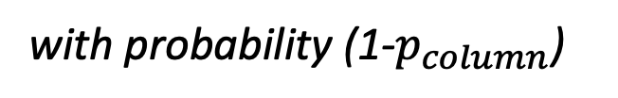
Retention-Replacement mechanism
*for each attribute of the table
with probability (1-$p_{column}$)
generate value from column’s pdf
replace
attribute
retain
with probability $p_{column}$
Adversary cannot differentiate replaced values
Replacement increases privacy but adds error
Retain some attributes, replace others
Notes:
Let’s see the mechanism behind the retention-replacement perturbation.
The first decision we make is to keep or randomize a value. We randomly decide, with a different probability for each column (p_column) to retain the attribute value otherwise we have to replace it. In the case of a replacement, we pick a random value from a distribution that corresponds to the column at hand, for example a uniform distribution with the same range of values. Both the probability and distribution is known, only the actual random values are private.
The mechanism is quite simple. Βecause of the replacements, the adversary cannot infer which values are original. Now the problem is that when evaluating queries, the replacements also introduce error. So the question is, how do we deal with that?

Slide 16
Aggregate reconstruction
Aggregates on perturbed data suffer from error
Idea: sample of retained data&from replacing pdf
remove estimated effect of replacement
estimate using retained sample
Reconstruction
Queries on T
Aggregates on T
revised answer = 2
for multi-column
Translation
Reconstruction
Queries on T’
Aggregates on T’
T’
select count(*)
from table
where salary > 6000
answer = 3
Notes:
Here, we focus on aggregation queries. That’s because individual values have been randomized already with some probability so they can be largely inaccurate.
The main insights here are the following: First, we have a sample of data that has been retained and if we isolated it, we could estimate the query result. Second, we know the replacing distribution and we can estimate its effect on the aggregate. Therefore, we compute the aggregates on the perturbed data, then we remove the impact of the randomization and finally use the contribution of retained values to the aggregate to estimate the actual aggregate value. This process is known as reconstruction.
REPHRASE following the example on the slide: To get an idea about the whole procedure, first we get queries on the data and we transform them to a set of other queries-this occurs for multi-column queries because we care about the correlations of the column values. Then we execute the queries on the perturbed database, get the results and finally perform the reconstruction. This gives an estimated result in a privacy-preserving ways.

Slide 17

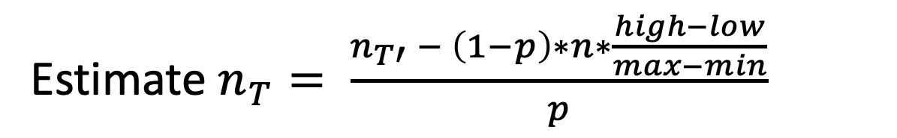

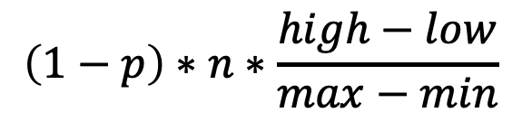
Reconstructing single-column count
Assuming uniform replacing pdf in [min,max]
select count(*) from table where low<salary<high
estimated count of original values
salary
10500
7500
6900
4000
$$p∗n_{T}$$
+
$$n_{T′}$$
$$\left(1−p\right)∗n∗\frac{high−low}{max−min}$$
estimated count from replacements
Estimate $n_{T}= \frac{n_{T′} − \left(1−p\right)∗n∗\frac{high−low}{max−min}}{p}$
Maximum Likelihood, accurate for large n
Notes:
Now, let’s see how the reconstruction mechanism works for count aggregates. We’ll assume a uniform replacing distribution with the same range as our values and an interval predicate low < salary < high
First, let’s consider the retained values (black font). The expected count of retained values that satisfy the predicate is the count of satisfying values in the complete original column n_T, scaled by the retention probability p.
Then, for the replaced values, we actually know the distribution so we can estimate the contribution to the count as a given formula.
The result of the query for the perturbed column, n_T’, is the sum of the two quantities. Now we can solve for the count on the original table and get a formula for an estimator of the count on the original data. This estimator is proven to be a maximum likelihood estimator (maximizes probability based on the observations) and has small error bounds for large enough tables.

Slide 18
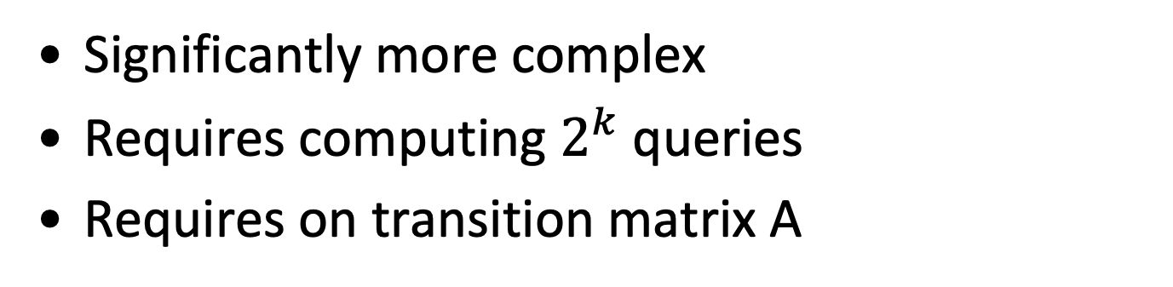
Reconstructing multi-column count
Significantly more complex
Requires computing $2^{k}$ queries
Requires on transition matrix A
Query | Aggregates(T) | Aggregates(T’)
Compute y
Compute transition matrix
Estimate x
Inverted A
Bayesian inference
Notes:
Using the same approach we can compute counts with predicates on multiple columns.
However, this is significantly more complex because we need to take into account the correlation of satisfying different combinations of the k-predicates. The corresponding math is complicated so we will not expand the discussion however interested students can check the original paper.
We need to compute the 2^k queries with all the combinations of predicates and their negation. The reason for this is that because of the randomization, the set of predicates that the row satisfies changes. Not all such transitions have equal probability. We keep the different counts and combine them with the transition probability we will see in a moment. So, with these counts we create a vector of results on perturbed data
Then, we have to use what is called a transition table, a 2^k x 2^k table that captures the probability of a record belonging in one predicate combination being counted to another combination due to the replacements. The transition table is the tensor product of per-predicate transition probabilities. We will not focus on it for the purpose of the course.
Once we have the transition matrix and the 2^k queries, we can estimate the count for the predicate combinations on the original data either by inverting the transition matrix and multiplying it with the aggregate vector on the perturbed data or use a fixed point algorithm based on Bayesian inference.
Transition matrix: record belonging to query i now belongs to query j

Slide 19
Applications in data mining
Data mining (a.k.a. ML) critical for applications
regulation restricts use on private data
Use randomized data to train models
error when training on randomized data due to noise
Train model based on reconstructed queries
Age < 30
Decision tree for credit risk
based on personal info
Salary > 30k
low
(115, John, 35k, 24)
Age < 21
high
high
low
Notes:
Count queries make for some nice statistics but are not too useful. But can we use the randomization approach for more complex tasks?
We will see that we can build randomization schemes even for complex operations such as ML or data mining which have been quite useful for several stakeholder in recent years and have received significant traction. This field includes models from decision trees to neural nets. We will keep it simple and focus on a decision tree.
A decision tree works as follows:
in each inner node we have a predicate and in the leaves we have classes, decisions about what kind of category an input tuple is in
for each level, we evaluate the predicate and follow the corresponding path
eventually we reach a leaf. then we infer the class for the input tuple
It is often the case however that training on sensitive data is regulated or illegal. A privacy preserving method would be very useful
We can always get the randomized data as is and use it directly for training, but results will be poor because of the noise in training data, misclassifications and overall distortions in the models
We will see how we can use reconstruction techniques to build such models

Slide 20
Applications in data mining
Build models i.e. decision trees with counts
Consider class variable as another column
Decision tree for credit risk based on personal info
Age < 30
Compute gini index with
(Age ≥ 30)∧Low, (Age ≥ 30)∧High,
(Age < 30)∧Low, (Age < 30)∧High
to decide splits
Salary > 30k
low
Do not partition perturbed data
Use all predicates in the path
Age < 21
high
high
low
Data mining with privacy-preserving primitives
Notes:
A count aggregate appears to be very simple and we saw how we can reconstruct them. However, we can use this operation to build more complex operations. An interesting proposal for randomized data has been to use them to build ML models.
Let’s see an example on how we can build a decision tree based on the count on randomized data. We assume that we have two classes and that we introduce them to the table as yet another column.
Similarly to building a normal decision tree, we start with all the data at the top. For each candidate split predicate, we can create a family of queries of counts in order to compute the gini index. For example, for a split in Age we could create queries with predicates (Age ≥ 30)∧Low, (Age ≥ 30)∧High, (Age < 30)∧Low, (Age < 30)∧High. Then, we can use the gini index to decide on a splitting predicate.
Once, we go down the new paths, top-down, we decide on new splitting predicates. Here we go through the same procedure to compute the gini index. But we have to take into account one detail:
We do not partition on the perturbed data. Otherwise, we would propagate errors from perturbations on the replaced values of the predicate columns.
Instead, we add the predicates of the prefix of the path to our queries once we go down (for example all the queries on the left subtree will include (age < 30)) and run the families of queries on all the data to account for the multi-column transitions.
Then, we will continue until we have separated the classes or decided to prune the tree. The end result is a tree build in a way that respects the privacy of the people whose information is used for training.
https://en.wikipedia.org/wiki/Gini_coefficient

Slide 21
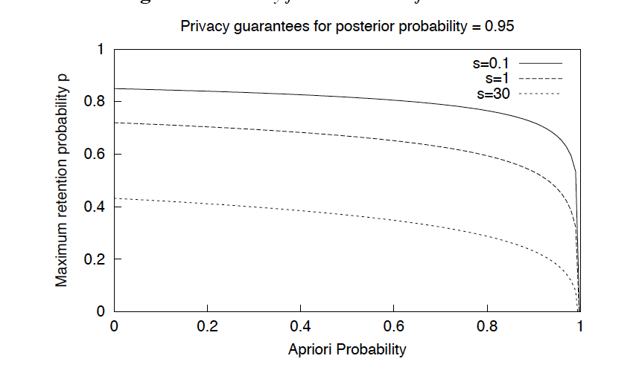
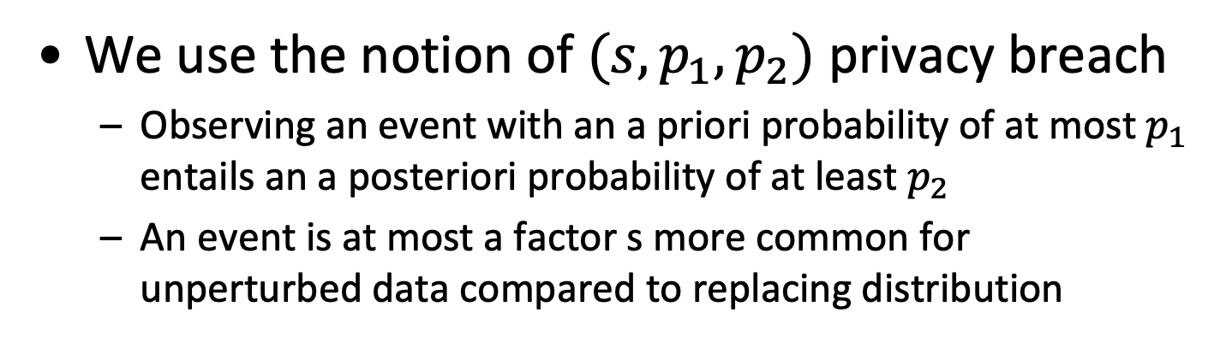
Randomization guarantees
We use the notion of $(s, p_{1}, p_{2})$ privacy breach
Observing an event with an a priori probability of at most $p_{1}$ entails an a posteriori probability of at least $p_{2}$
An event is at most a factor s more common for unperturbed data compared to replacing distribution
query with predicate
on 3-columns
no (1, 0.4, 0.95) breach
Set p for the desired guarantee
Privacy-error tradeoff
Notes:
Now, we’ll see the privacy guarantees that this approach can provide. We define privacy breaches as follows:
there is a privacy breach if observing an event for a record in the perturbed data gives a higher a posteriori probability for an event on the corresponding original data compared to the a priori probability. So observing the event suggests that it holds for the original data as well.
A priori probability is a probability that is derived purely by deductive reasoning. if there are N mutually exclusive and collectively exhaustive events and if they are equally likely, then the probability of a given event occurring is 1/N. Similarly the probability of one of a given collection of K events is K / N.
A posteriori probability or the empirical probability, relative frequency, or experimental probability of an event is the ratio of the number of outcomes in which a specified event occurs to the total number of trials
also there is a privacy breach if an event is much more common in the original data when compared to the replacing distribution. Then, if we observe the event, we know the value comes from retention with high probability and this constitutes a violation of the privacy scheme.
The formal definition of a (s, p_1, p_2) breach is shown here in the slide
So what we see in the graph here, which plots the maximum retention probability for a 3-column query that can give a specific guarantee against the a priori probability of events, we see that we can have relatively high retention rates until we get to very common events = high a priori probabilities. So the adversary cannot be entirely sure, whether observing an event is because of the replacement or the retention even if we retain a majority of the values.
For larger values of s, we need lower retention probabilities because we have to compensate for events that are significantly more common in unperturbed data. So observing them would normally mean that the data is retained.
To give an example of the graph, we see that when the apriori probability of an event is 0.4, then to get a guarantee that the adversary cannot infer with more than 95% probability when s is 1, we need to replace only 30% of our records.
In any case, we see the convenient property that the retention probability is a parameter for the desired property guarantee and we can set it to target the privacy error tradeoff.

Slide 22
Take-away: Data Perturbation
Publish a randomized dataset
Simpler to query
Compose complex procedures
Other retention replacement schemes
Extensible for categorical data
Breaks data integrity
Notes:
So now we saw a way that allows publishing data, that we can query them directly and also build more complex operations on top of the technique.
Of course, retention replacement is not absolute. We can use other distributions or we can use other randomization schemes. And we can also extend support for categorical or discrete data
On the downside, we have the error introduced and the integrity of the data broken. Invariant holding for the original data do not work out anymore.

Slide 23
Privacy-preserving data management
Operations across private databases
Data Perturbation
k-Anonymity
Differential Privacy
Notes:
Earlier we saw that we can publish randomized data but we lose integrity.
Now, let’s examine a privacy scheme that keeps data accurate
L. Sweeney. K-Anonymity: a model for protecting privacy. Intl. Journal on Uncertainty, Fuzziness and Knowledge- based Systems, 10(5), 2002.
https://epic.org/privacy/reidentification/Sweeney_Article.pdf
(link promts to print, press cancel and you are good to go)
L. Sweeney. Datafly: A system for providing anonymity in medical data. In Proceedings of Eleventh International Conference on Database Security, pages 356-381. Database Security XI: Status and Prospects, 1998.
https://dataprivacylab.org/datafly/paper2.pdf
sections 3.5 and 3.6
Machanavajjhala A., Gehrke J., Kifer D., and Venkitasubramaniam M.: l-Diversity: Privacy Beyond k-Anonymity. ICDE, 2006.
https://www.utdallas.edu/~muratk/courses/privacy08f_files/ldiversity.pdf
section 1.1 (and 4 has the solution)

Slide 24

Publishing sensitive data
Publish factual data useful for analysis
Avoid identification of people with records
Cannot we just remove candidate keys?
?
Notes:
The scenario here is that we want to publish a version of the data that can be used publicly, for example by the research community. For the analysis, they need factual data that can be used in order to draw some conclusions.
Still, we want the published data to respect the privacy of the people they reference, for example we don’t want to report that a certain person has been diagnosed with a specific disease. So, we essentially want to publish a subset of the data can be useful for interested parties but it should be impossible to identify the people that the records refer to.
So, the first idea that pops to mind is, why not just drop the columns that can be used as identifier, essentially the candidate keys

Slide 25
Suppressing identifiers
Common approach: remove candidate keys from the relations
Name | Address | Phone# | Birth date | ZIP | Gender | Diagnosis
Alice | … | … | 01/02/98 | 1006 | F | Flu
Bob | … | … | 03/08/99 | 1005 | M | Fracture
John | … | … | 07/12/73 | 1004 | M | Cancer
Mary | … | … | 01/08/85 | 1006 | F | Hepatitis
Birth date | ZIP | Gender | Diagnosis
01/02/98 | 1006 | F | Flu
03/08/99 | 1005 | M | Fracture
07/12/73 | 1004 | M | Cancer
01/08/85 | 1006 | F | Hepatitis
Is this approach sufficient?
Notes:
This is actually a common approach in practice. Let’s see an example:
Suppose that we have a table of medical data from a hospital and for each case we record the details of the person and information on the diagnosis.
Now, we can identify which attributes are unique and as a result, candidate keys. The name of the person, any id numbers, the phone number and in some formats the address could be unique. So, some data owners remove these columns and publish the rest such as the date of birth, the zip code and the gender.
Now, let’s repeat the question again. Is this sufficient?

Slide 26
Quasi-Identifiers: how to crack them
Name
Voter registration data
Medical
data
ZIP
Address
Diagnosis
Birth date
Phone
Gender
Party
Reality check:
Unique for 87% of US residents
(ZIP, Birth date, Gender) is quasi-identifier
“William Weld was governor of Massachusetts at that time and his medical records were in the GIC data. Governor Weld lived in Cambridge Massachusetts. According to the Cambridge Voter list, six people had his particular birth date; only three of them were men; and, he was the only one in his 5-digit ZIP code.”
Linking to other data breaks anonymity
Notes:
The answer is no.
Let’s suppose that we have our released medical data, from which we have dropped the unique columns. Also, let’s take another publicly available dataset such as the voter registration data, Then, we will see that some of the remaining attributes are common.
Here, we have to note two important issues:
first, the voter registration data is not anonymized so we have the identifying attributes and we know the values of the common attributes, the zip code, the birth date and the gender, for each person
second, while the attributes that the 2 datasets have in common are not unique, they come close to it. In fact, this triplet of attributes is unique for 87% of the US residents. This is what we call a quasi-identifier because it is not an identifier but comes close.
Given the two issues we noted, if we perform a join for the quasi-identifier we can identify the majority of the people in the released table of medical data.
Sweeny, the author of the first paper on k-anonymity, notably narrated about how he was able to find the medical diagnosis for William Weld, governor of Massachusetts back in the 90s.
So now we saw that we have quasi-identifiers, we saw the risk of linking attacks and we saw that the naïve approach does not work out overall.

Slide 27
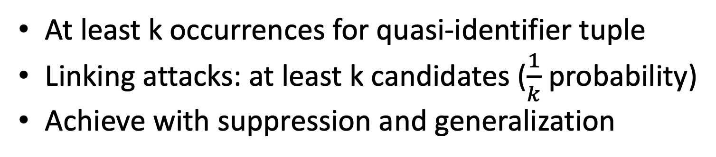
k-Anonymity
At least k occurrences for quasi-identifier tuple
Linking attacks: at least k candidates ($\frac{1}{k}$ probability)
Achieve with suppression and generalization
Nationality | Birth year | Gender | Diagnosis
Spanish | 1965 | m | Short breath
Spanish | 1965 | m | Chest pain
French | 1975 | f | Hypertension
French | 1975 | f | Hypertension
Swiss | 1964 | m | Obesity
Swiss | 1964 | m | Chest pain
Swiss | 1964 | m | Short breath
equivalence class
2-anonymity
example
Protect from linking attacks
Notes:
So, what do we do about linking attacks. The solution that Sweeny proposed is k-anonymity.
k-anonymity is essentially a property that we want to hold for our released data. We want each value combination in a quasi-identifier to have at least k occurrences.
As an example, take a look at the table shown in the slide. Assuming that the quasi-identifier is (Nationality, Birth year, Gender) we see that each combination of values occurs at least 2 times, which means that we have 2-anonymity. In case of a linking attack, this quasi-identifier will link each person to at least 2 different records in the released table, so the probability that we guess which record is the correct one is 50% at worst.
In general, k-anonymity means that each linking attack results in k candidate records and the probability of correct disclosure is 1/k. The higher the k, the better the guarantee.
The important question is, how do we achieve this type of property. We already saw one way suppression which results in discarding columns completely but this is usually too coarse-grained and using it beyond identifiers can make the data useless. The other way to go is to generalize data. Let’s see what that means in the next slide.

Slide 28
Generalizing attributes
Birth date | ZIP | Gender | Diagnosis
01/02/98 | 1006 | F | Flu
03/08/99 | 1005 | M | Fracture
07/12/73 | 1004 | M | Cancer
01/08/85 | 1006 | F | Hepatitis
Generalize to value range
Attribute still usable
Achieve k-anonymity
Birth date | ZIP | Gender | Diagnosis
199* | 1006 | F | Flu
199* | [1000-1005] | M | Fracture
197* | [1000-1005] | M | Cancer
198* | 1006 | F | Hepatitis
Birth date | ZIP | Gender | Diagnosis
01/**/** | 1006 | F | Flu
**/**/** | [1000-1005] | M | Fracture
**/**/** | [1000-1005] | M | Cancer
01/**/** | 1006 | F | Hepatitis
More fine-grained than suppression
Notes:
The generalization approach comes from the observation that values can be represented in different granularities creating a hierarchy of values. Starting at the bottom we have the most accurate values and going upwards we have broader ranges. There are multiple ways to go to determine the hierarchy.
So, what we end up doing is replacing specific values with a range of values. Then, the resulting attribute might still hold some value for the analysis even though the table is k-anonymous
In the example, we apply this idea for ZIP codes. We replace codes 1004, 1005 to a whole range of zip codes, from 1000 to 1005 which is a step towards anonymity. We also apply the idea to the birth dates. For the two female patients, we only keep the fact that they were born in January and generalize the rest of the date string.
We see that we can take fine-grained decisions. As an example, we don’t have to generalize 1006 zip codes as well. [1000-1005] is enough to achieve k-anonymity and we do not need to sacrifice more accuracy for our data. Additionally, we can suppress only some values in a column such as birth-date.

Slide 29
How to achieve k-anonymity
Minimal k-anonymization is most useful
Minimal k-anonymization is NP-hard
Optimal heuristic algorithms e.g. k-Optimize
Suboptimal but practical algorithms e.g. Datafly
Notes:
We have discussed the techniques but we still haven’t given a concrete algorithm on how to achieve k-anonymity
Actually, we want to use the techniques we mentioned in order to get a k-anonymized dataset that retains the most information possible. We refer to this as minimal k-anonymization.
Otherwise, we could suppress everything but the data would not be useful.
Minimal k-anonymization is not an easy problem to solve. It has been proven for k >= 3 that minimal k-anonymization is NP-hard so it is an expensive algorithm.
In practice, we won’t use brute force. We have two options here:
We perform a heuristic search. It will return an optimal solution and in reasonable time in many cases but not all
The other approach is to use practical polynomial algorithms that are efficient but do not yield optimal results. We will see one such case, the Datafly algorithm, which is the oldest scheme that the original author of k-anonymity himself proposed

Slide 30
Datafly: An Overview
Generalize infrequent QI values
Drop when outliers are few
QI: quasi-identifier
Count number of records
for each QI value
Sum number of records in small groups (fewer than k)
sum > threshold
sum ≤ threshold
Generalize field with
most distinct values
Drop records in small groups
k-anonymous
Notes:
The idea behind datafly is to find infrequent quasi-identifier values (here we mean tuple of values from original fields) and then generalize them. Such values could be the potential targets for any linking attacks. If a value of a quasi-identifier is very common then linking with it would come at little risk
Also, another concept of the algorithm is that we do not have to match everything to the anonymization scheme. We can tolerate dropping a percentage of our data defined by the threshold.
The algorithm is executed as follows given an interesting QI
first, we count the number of occurrences for each QI value (essentially a histogram on the QI set of fields)
second, we find the buckets, that means the anonymization class, with fewer than k values. In other words, which values of the QI would violate k-anonymity if the table is released as is. Once we find those buckets, we compute the aggregate count of records across all of those buckets.
third, we check if we can afford to drop the buckets with few occurrences. This can happen if the aggregate count is smaller than a threshold set by the algorithm. if yes, then we drop the records and we are k-anonymous for this QI
finally, if we cannot afford dropping the buckets that violate k-anonymity, we have to generalize our data. To simplify the process, the algorithm picks the column that has the highest number of buckets because it expects a greater reduction of infrequent buckets as a result.
There is no specified way to perform the generalization. In that respect the algorithm is generic and compatible with any reasonable scheme.
After generalization, we repeat the algorithm to test if it was enough to eliminate the buckets violating k-anonymity
L. Sweeney. Datafly: A system for providing anonymity in medical data. In Proceedings of Eleventh International Conference on Database Security, pages 356-381. Database Security XI: Status and Prospects, 1998.
https://dataprivacylab.org/datafly/paper2.pdf
sections 3.5 and 3.6

Slide 31
Attacks on k-anonymity
k-anonymity is vulnerable
Homogeneity attack
Unsorted matching
Temporal attack
Complementary release attack
Notes:
k-anonymity is not a silver bullet. It is still vulnerable against a series of attacks. Some prominent attacks are unsorted matching, complementary release attacks, temporal attacks and homogeneity attacks. We’ll explain how they are done and how we can take measures against them.

Slide 32
Unsorted matching
In relational model, we cannot assume order
In practice, for DBMSs, we can
Nationality | Birth year
Spanish | 196*
Spanish | 196*
French | 197*
French | 197*
Swiss | 196*
Swiss | 196*
Swiss | 196*
Nationality | Birth year
W. Europe | 19*5
W. Europe | 19*6
W. Europe | 19*5
W. Europe | 19*6
C. Europe | 196*
C. Europe | 196*
C. Europe | 196*
Nationality | Birth year
Spanish | 1965
Spanish | 1966
French | 1965
French | 1976
Swiss | 196*
Swiss | 196*
Swiss | 196*
+
Tuple re-ordering protects from matching
Notes:
The first attack type is unsorted matching. In theory, tables are not ordered in the relational model, the records constitute a set. In practice however, records have an order in which they are sorted due to the way they are stored. And if for some reason, this order is the same across two tables, we can link them due to this property.
For example, let’s suppose that you are given two tables that are 2-anonymous using different approaches. They are 2-anonymous using their own scheme but they are ordered in the same way. Then, if we use this information, we can reconstruct a new table that combines the data of the two releases. Here we see that by merging the tables, we get a table that is not anonymous if nationality, birth year is the quasi-identifier. Thus, the property is compromised and the first four records can be re-identified.
How do we solve this? The answer is almost trivial, we only need to randomly reorder our records.

Slide 33
Complementary release attack
Different quasi-identifiers across releases
Other releases are also external sources
Nationality | Birth year | Gender | Diagnosis
Spanish | 196* | m | Hypertension
Spanish | 196* | m | Chest pain
Swiss | 197* | f | Fever
Swiss | 197* | f | Vomitting
Linking on diagnosis reverses generalization of values
Birth year | Gender | Diagnosis
1965 | m | Hypertension
1965 | m | Chest pain
1974 | f | Vomiting
1974 | f | Fever
Include sensitive attributes in quasi-identifier
Notes:
Another threat is the complementary release attack. As the name suggests we need multiple releases of the same data.
let’s suppose that we used different quasi-identifiers and anonymity schemes to get our k-anonymous tables. For example, for the first table we have (nationality, birth decade, gender) and for the second one we have (birth year, gender).
on their own, the quasi-identifiers are safe because we have enforced k-anonymity. but there is a trick. We notice that the diagnosis values are unique and therefore we can link the tables using them. The end result is a table that discloses more information for each individual and potentially breaches privacy
To fix that, we have to take an extra step of protection. We need to include the sensitive data, the diagnosis in this case, in the quasi-identifier as well. Then, the result will be that we have duplicate records but at least we will be safe against complementary releases.

Slide 34
Temporal attack
Different k-anonymity scheme for updated table
Nationality | Birth year | Gender | Diagnosis
Spanish | 196* | m | Hypertension
Spanish | 196* | m | Chest pain
Swiss | 197* | f | Fever
Swiss | 197* | f | Vomitting
Birth year | Gender | Diagnosis
1965 | m | Hypertension
1965 | m | Chest pain
1974 | f | Fever
1974 | f | Vomiting
19*3 | f | Hypertension
19*3 | f | Headache
Anonymize released tables
+ updated records
-cannot leak extra info
Make new release compatible with older ones
Notes:
Another type of attack is the temporal one.
Let’s suppose that the database at hand is not static and we have to deal with updates. We integrate new tuples to the private table.
Then again the anonymization algorithm might choose a different way to achieve k-anonymity because it has a different input. We show an example in the slide.
From then on, the mechanics are pretty similar to what is already known from complementary releases. We link together the old release and the release with the updates to disclose information.
To solve this problem, what we have to do is to base the new release on older releases, in order to stay consistent. So, instead of updating the private table and then anonymizing it, we can integrate our updates to the older release and then anonymize it again. By doing that, no extra information can be leaked from records already in the released data and the solution is to be backwards compatible.

Slide 35
Homogeneity attack
Nationality | Birth year | Gender | Diagnosis
Spanish | 1965 | m | Cancer
Spanish | 1965 | m | Cancer
French | 1975 | f | Hypertension
French | 1975 | f | Hypertension
Swiss | 1964 | m | Obesity
Swiss | 1964 | m | Chest pain
Swiss | 1964 | m | Chest pain
Sensitive values lack diversity ⇒ inference
Require multiple well-represented values per class
⇒ probabilistic inference
Require evenly distributed values
Notes:
Machanavajjhala A., Gehrke J., Kifer D., and Venkitasubramaniam M.: l-Diversity: Privacy Beyond k-Anonymity. ICDE, 2006.
https://www.utdallas.edu/~muratk/courses/privacy08f_files/ldiversity.pdf
section 1.1 (and 4 has the solution)
Finally, we have homogeneity attacks
Homogeneity attacks are caused by lack of diversity in the sensitive values of an anonymity class. Let’s take a look at the example in the slide. All the patients with the quasi-identifier value (Spanish, 1965, M) have cancer so despite k-anonymity, the adversary can tell by linking that a person that matches this category has cancer, even though they cannot find the corresponding record. So lack of diversity allows inference
Then, we can require that each class has multiple well-represented values for the sensitive field. This will solve the problem of exact inference. But there is still the problem of probabilistic inference. for example for the quasi-identifier value (Swiss, 1964, M) have 2 different sensitive values but the adversary can assume that with 66% probability a record linking with this category will have chest pain
So, to solve that issue as well, we have to take yet another step back and represent each of the sensitive values roughly equally. For many datasets however, such a requirement is too restrictive because some values are very common.

Slide 36
Take-away: k-anonymity
Robust privacy guarantees
Complexity of minimal k-anonymity
Vulnerable to range of attacks
Notes:
All in all we saw k-anonymity which has a robust way of quantifying privacy. The more candidate to link to, the more secure the privacy
Still, there is the issue of achieving k-anonymity. The problem is NP-hard so usually minimal k-anonymity is not practical and practical approaches are not minimal
Finally, we saw that despite efforts, attacks still exist, and are not limited to the ones we presented. While we can mitigate some threats, usually there are more to come.

Slide 37
Privacy-preserving data management
Operations across private databases
Data Perturbation
k-Anonymity
Differential Privacy
Notes:
So, we saw that potentially the privacy of the previous approaches can be breached under some circumstances. The final type of privacy-preserving techniques we see is differential privacy and provides stronger guarantees.
Main paper:
C. Dwork et al, Calibrating Noise to Sensitivity in Private Data Analysis, In Theory of cryptography conference, 2016.
https://link.springer.com/content/pdf/10.1007/11681878_14.pdf
Crash course on differential privacy:
Berkeley lecture material
https://people.eecs.berkeley.edu/~stephentu/writeups/6885-lec20-b.pdf

Slide 38



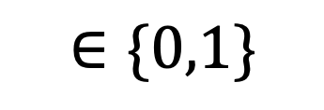
Differential privacy
$$∈\{0,1\}$$
“sum=25”
A
?
A
$$=1$$
?
“sum=24”
$$=0$$
Privacy breach
Notes:
At a conceptual level any information that we reveal about a database is a function of the database. We will figure out what kind of functions we need to protect the privacy in our database
Let’s first consider a sum over the data. Does it protect the privacy?
To simplify, let’s assume we have binary data, 0s and 1s, and we are computing the sum. Also, let’s suppose that we have an adversary observing the values of that function for 2 database instances that differ in one element that the adversary does not know. Now if they have the sum, and the sums differ by one, they know that one element is 1 and the other is 0
That is a privacy breach. So, in this context a sum is not privacy preserving
We will define the type of functions we can use through the notion of differential privacy

Slide 39
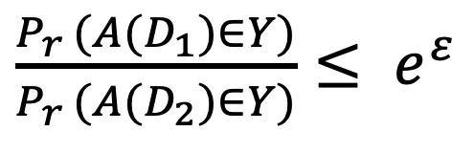
Differential privacy
A randomized algorithm is differentially private if the difference in the results is statistically insignificant for neighboring databases
Neighboring=differ in at most one element
?
?
?
A
?
A
?
A is ε-differentially private iff
$\frac{P_{r }(A(D_{1})∈Y)}{P_{r }(A(D_{2})∈Y)}≤ e^{ε}$
More rigorous privacy guarantees
Notes:
Let’s define what differential privacy means
Suppose that we have two databases that differ only for one record, we call these databases neighbors
Also, let’s suppose that we have an adversary that can observe the output of an algorithm over these databases
Then, the property that we want to achieve is that the adversary should be unable to differentiate between the two databases by just observing the outputs
To formalize this property, the algorithm is randomized so it returns a set of possible values and the difference in the outputs for neighboring databases should be statistically insignificant
The statistical insignificance is expressed by the condition that the ratio of the probabilities that the output belongs to a set Y for each of the databases is bound and the bound is exponential to an epsilon parameter
This rigorous definition of privacy will guarantee several interesting properties

Slide 40
The strength of differential privacy
Alice
Bob
👧
n-1 records
👦
= ?
A( )
Bob cannot infer info about individual records
n records
Extrapolation as accurate as random guess
Notes:
Now let’s see how this works in practice through a game-like setup
we have Alice and Bob and Alice has a database of n records
Alice takes one record out of the database and sends the new set of n-1 records to Bob
Alice computes the output of an epsilon-differential algorithm over the complete original database and sends it to Bob as well
Now, Bob has to somehow infer the element that Alice excluded
The guarantee that differential privacy gives us is that Bob’s extrapolation will not be significantly better than a random guess. This way, privacy is assured because Bob cannot tell anything about individual records

Slide 41
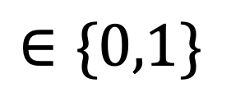


Differential Privacy: 0-1 example
Alice
, A( )
$$∈\{0,1\}$$
Bob
👧
👦
= ?
A( )
With differential privacy:
$P_{r}(Bob correct)≤$ $\frac{1}{2}+\frac{ε}{2}$
Without differential privacy:
$P_{r}(Bob correct)=$ $1$
under some circumstances…
Extrapolation as accurate as random guess
Notes:
To get a better sense of the result, we focus on the binary case in which both the record values and the function output is binary {0,1}
When the algorithm is differentially private, then the probability that Bob guesses right given the information from Alice is at most slightly better than a coin toss
However, if the algorithm wasn’t differentially private, for example if it was a parity function, then Bob would be sure to guess correctly.
So, this means that it is safe to share the output of differentially private algorithms without compromising privacy.

Slide 42



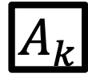
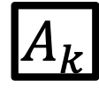

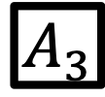



Composability
Sequential composability
Parallel composability
$$A_{1}$$
$$A_{2}$$
$$A_{3}$$
…
$$A_{k}$$
$$z_{2}$$
$$z_{3}$$
$$z_{4}$$
Composition result is kε-differentially private
part 1
$$A_{1}$$
Composition result is ε-differentially private
part 2
$$A_{2}$$
…
x
x
part k
$$A_{k}$$
Notes:
An interesting property of differentially private algorithms is composability because we can use simple algorithms to make more complex ones. We have two types of composability: sequential and parallel
First, we examine sequential composability. The idea here is that we execute a sequence of epsilon differentially private algorithms. In each algorithm, the input is the complete database as well as the output of all preceding algorithms as metadata. Then, it can be proven that the overall algorithm that consists of this sequence of operations is also differentially private, with a parameter of e * number of steps
Second, we have parallel composability. In this scenario we have k partitions and corresponding differentially private algorithms. Starting from partition 1 we start executing the respective algorithm for each partition, incorporating the outputs of preceding algorithm executions. The end result is also epsilon differentially private. [This structure can be mapped to basic structures such as a loop with side-effects]

Slide 43
How to achieve differential privacy
Differential privacy has desired properties
But how do we design such algorithms?
We can use the Laplace Mechanism
f
+
A
Noise
(Laplace Distribution)
Randomized algorithm is differentially private
Notes:
We already talked about differentially private algorithms but we still haven’t described how we can make them
Ideally, we would like to get an equivalent differentially private algorithm for each function that we can think of
There is way to do this transformation which is called the Laplace Mechanism. This mechanism works as follows
first we compute the desired function over the database: and this produces the accurate result. Producing that as an output would potentially breach the privacy.
then, comes the step that actually achieves differential privacy. The driving idea is to add noise to the output of the function that is generated from a Laplace distribution. Then, this noise will introduce the desired fuzziness for differential privacy
now, the only detail that remains is to decide on how much noise we require, in other words what are the correct parameters for the Laplace distribution

Slide 44
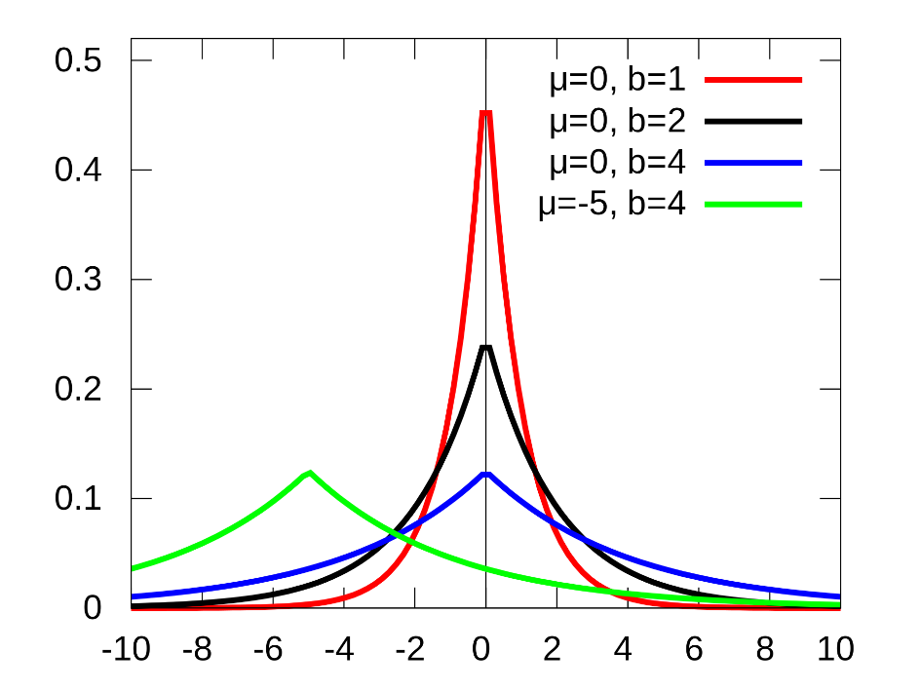
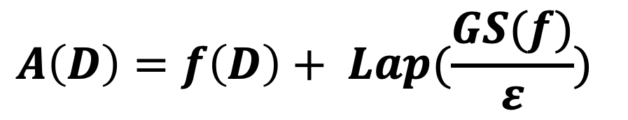

Global noise sensitivity
Required noise depends on function properties
Global noise sensitivity: distance of neighbors
Produce noise with parameterized distribution
$$GS\left(f\right)= \sup_{D_{1}{,D}_{2}∈D^{n}}||f\left(D_{1}\right)−{f(D}_{2}){||}_{1}$$
for neighboring $D_{1},D_{2}$, then
$$A\left(D\right)=f\left(D\right)+ {Lap(\frac{GS(f)}{ε})}^{}$$
Notes:
There is no general guideline for the required noise, it depends on the function that we want to make differentially private
The dependence comes from the notion of global noise sensitivity. Sensitivity quantifies the impact of distinguishing records between neighboring databases to the output of the function. Essentially, it is the maximum distance of the function outputs for two neighbors.
Now, we use this distance as a parameter to a Laplace distribution to generate the appropriate noise. (If the output is multidimensional, we have to raise the error to the number of dimensions). By adding this error to the function output, we get a differentially private algorithm.
A large parameter number means that the noise is more spread out. This insight is reasonable because for large differences across neighbors, we have to compensate with more noise.

Slide 45
Laplace mechanism-based algorithms
Randomized algorithms
Noisy summation
Noisy average
Noisy linear regression
…
Laplace mechanism is pessimistic
Perturb objective function
Use Euclidean norm for vector-based
sum ✘
sum + noise ✓
Notes:
Now, using this laplace mechanism we can get a number of different algorithms. We can get a sum algorithm, an algorithm for average and even an algorithm for more complex operations such as a linear regression.
Still, Laplace mechanism is pessimistic because it introduces a significant amount of noise proactively. A small improvement would be to use a different distance metric. The original global noise sensitivity uses l1 norms but l2 norms would yield smaller values. Also, in many cases it is more reasonable to perturb the objective function, the statistic that we are calculating rather than introduce the noise at the end

Slide 46
Take-away: differential privacy
Strongest guarantees for the worst-case
Privacy-error tradeoff
Pessimistic in nature
Potential for relaxed definitions
Potential for specialized algorithms
Notes:
To summarize, we saw that with differential privacy we get strong guarantees that even hold for the worst case.
Also, we see that even here, the privacy error tradeoff holds. We get strong privacy but this comes at the expense of accuracy as we are adding noise
We saw that the Laplace mechanism is pessimistic, but in fact the whole concept of differential privacy over-provisions for the worst case so it is overall pessimistic.
This leads to an opportunity, which involves relaxed definitions of differential privacy. This way we can get more efficient and more accurate ways to achieve privacy in practice.
Also, we saw how differential privacy works with the general Laplace mechanism but we can also achieve differential privacy by perturbing the function in the algorithms themselves. This specialized approach can give tighter bound compared to general purpose techniques that add noise for the worst case.

Slide 47
Readings in Privacy
R. Agrawal, A. Evfimievski, and R. Srikant. Information sharing across private databases. In SIGMOD, 2003.
R. Agrawal, R. Srikant, and D. Thomas. Privacy preserving OLAP. In SIGMOD, pages 251–262, 2005.
L. Sweeney. K-Anonymity: a model for protecting privacy. Intl. Journal on Uncertainty, Fuzziness and Knowledge- based Systems, 10(5), 2002.
L. Sweeney. Datafly: A system for providing anonymity in medical data. In Proceedings of Eleventh International Conference on Database Security, pages 356-381. Database Security XI: Status and Prospects, 1998.
C. Dwork et al, Calibrating Noise to Sensitivity in Private Data Analysis, In Theory of cryptography conference, 2016.

Slide 48


Slide 49



Finding similar items
Stock market trends
Documents similarity
Shopping patterns
Notes:
In today’s otherside session we are going to talk about summarization tools and finding similar items in big collections.
Consider for example a big chain of supermarkets. The supermarket may want to detect customers that have very similar shopping patterns.
Similarly, to improve user experience, search engines want to remove duplicate and near-duplicate results from their suggestions. One way to do that is by comparing the words in each pair of pages and checking whether the two pages are similar. This approach has two main drawbacks: 1) it is quadratic to the number of pages, which can become prohibitive very quickly. 2) Even checking a single pair of pages can be expensive as each page itself may contain millions or billions of words, consider for example queries that return online documents and books. Ideally, we want to minimize the number of checked pairs AND make each check as cheap as possible.
In order to achieve that, in this session, we are also going to take advantage one more common property of these examples: the application requirements can withstand a small number of missed duplicates. The user may become annoyed but as long as the number of false positives is low enough, it will not impact his experience too much to withdraw from the service.

Slide 50
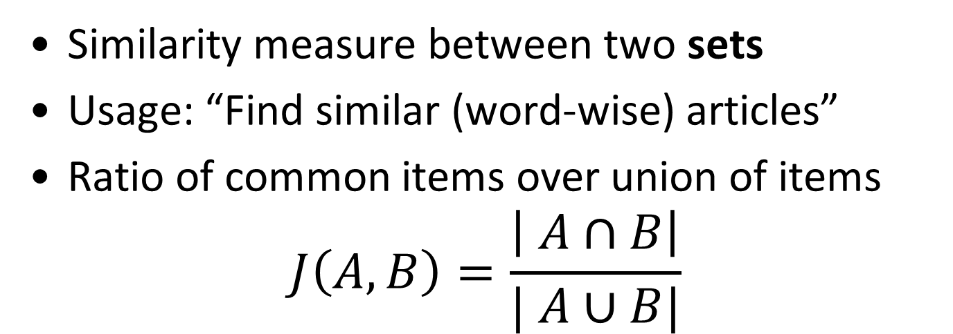
Jaccard similarity
Similarity measure between two sets
Usage: “Find similar (word-wise) articles”
Ratio of common items over union of items
$$J\left(A, B\right)=\frac{\left| A∩B\right|}{| A∪B|}$$
A
A
A
B
B
J = 0
J = 2/9
B
J = 1
Notes:
Generalizing a little bit, one of the very common ways to represent data is as sets. To find users with similar shopping preferences, shopping carts can be modeled as sets of products, discarding the frequency (cardinality) data. Similarly, for detecting documents with similar topics, we can consider only their words and represent the documents as sets of words. In both cases, we then want to find “similar” in sets. One common measure of the similarity of two sets is the Jaccard similarity that defines the set similarity by ratio of shared elements. More specifically, it is defined as the count of common elements between the two sets over all the elements that appear in any of them.
For example, if we have two sets <middle figure> A & B represented by red and blue respectively and with black dots for their elements, their Jaccard similarity is defined as the size of the overlap between the two sets, 2 dots in this case, over the size of their union, 9 dots here. So, for the middle case, their similarity is 2/9. By the definition of the measure, you can see that is maxes out at 1, when the two sets overlap (right-hand side) and is minimized at 0, when the two sets have no common elements (left-hand side).
Back to our case study, to compute the similarity of two documents, we have to scan the set representing each document and compute the size of their union and intersection. If we want to find all documents with x% Jaccard similarity, then we will have to repeat that O(N^2) times! Considering that each set may be big itself, possibly containing million or billion of distinct elements, it would actually be impractical to discard, let’s say duplicate results rom your google searches. Fortunately, in many applications we can benefit by the fact that we do not care about exact results and significantly improve the performance of finding similar items, which will be the focus of the rest of this session.

Slide 51
Sets to Bitvectors
Logically, represent sets as bitvectors
Each bit corresponds to a possible element
Bit is set iff element is contained in the set
J(A, B) = popcnt(A & B)/popcnt(A | B)
 | A | B
a | 1 | 0
b | 1 | 1
c | 1 | 1
d | 0 | 0
e | 0 | 0
f | 0 | 1
A = {a, b, c}
B = {b, c, f}
J(A, B) = 2/4
Notes:
So, let’s start step by step solving the aforementioned problems for the case of the Jaccard similarity and then we will see how we can generalize our results.
The first challenge is to decrease the effective size of each set, without loosing a lot of information.
(We can use a general compression algorithm, or we can use something specific to this metric to get even better results and allow us to apply approximations.)
To do so, let’s first change, at least in the logical level, the representation of the sets. Instead of representing them as (unordered) lists of items, we can represent them as bitvectors.
(Bare with me, we are not going to actually create this representation (which can possibly explode the data size), but it’s easier to introduce our compression in this form.)
For example, if we have these two sets, we can represent them with a sequence of 0/1s, by creating a matching between the different bits to the possible set elements. For example, assume that the possible elements are a-f and we use their alphabetical sequence to define the matching between bits and elements. Then, A is represented by the first column (111000) as it contains abc, while B does not contain a, so it has a 0 in the first row and it contains f, so it has a 1 in the last row.
Now, the first important observation is that we can still calculate the set (Jaccard) similarity. It’s the number of rows set to 1 for both sets divided by the number of rows that have a 1 in any line. Effectively, we count the number of 1s in their bitwise-or and divide it by the bitwise-and.
But even more importantly, we can start approximating the similarity!

Slide 52
From a bitvector to summarization
h(C) = index of first row where C is 1
ceil(log(N)) space per hash, N = |Ω|
 | A | B
a | 1 | 0
b | 1 | 1
c | 1 | 1
d | 0 | 0
e | 0 | 0
f | 0 | 1
h(A) = 0 (a)
h(B) = 1 (b)
A = {a, b, c}
B = {b, c, f}
Notes:
Instead of storing the whole bitvector, we can cheat a little bit. We can store, for each set, only the offset of the first column that is non-zero and… we are almost done. We have created our first summarization.
Let’s see that in our example. Instead of keeping the 6 bits for A, we only maintain the information that the first bit of the vector is at row 0, so we map A to h(A)=0. Similarly, for B, a = 0, b = 1, so h(B) = 1.
From the space perspective, if we have N possible elements in total, we now store each set using O(log(N)) space – or equivalently, the same as storing just a _single_ (the “first”) element per set!
But what happens now with the computing the Jaccard similarity? Apparently, and thankfully, with a small modification we can get some guarantees.

Slide 53
Minhashing
Randomly permute rows
Minhash: h(C) = index of first row where C is 1
Considering all permutations: P(h(A) = h(B)) = J(A, B)
ceil(log(N)) space per hash, N = |Ω|
 | A | B
a | 1 | 0
b | 1 | 1
c | 1 | 1
d | 0 | 0
e | 0 | 0
f | 0 | 1
 | A | B
e | 0 | 0
f | 0 | 1
a | 1 | 0
c | 1 | 1
b | 1 | 1
d | 0 | 0
A = {a, b, c}
B = {b, c, f}
h(A) = 2 (a)
h(B) = 1 (f)
Notes:
Minhashing adds some more randomness to get the mathematics in our side: before finding the first non-zero row,it randomly permutes the rows, using the same permutation for all sets. In this example, we shuffle the rows to have “e” first, “f” second, etc, instead of the alphabetical order. Based on this permutation, the new representations/hash-values for A & B are 2 & 1 respectively.
Adding the random shuffling, removes the bias due to the arbitrary ordering and thus selecting a random permutation of the rows, makes the probability of having the same hash value for two sets equal to their Jaccard similarity. In other words, if we shuffling the rows and compare the hash value of two sets “enough” times, the expected number they matching rate will be their Jaccard similarity.

Slide 54
Minhash Signature
Repeat for multiple (independent) permutations
Signature similarity = fraction of equal hashes
Sim(minhash-sig(A), minhash-sig(B)) = 1/3
Expected sig similarity = Jaccard similarity
E[Sim(minhash-sig(A), minhash-sig(B))] = J(A, B)
Expected error decreases as sig size increases
 | A | B
a | 1 | 0
b | 1 | 1
c | 1 | 1
d | 0 | 0
e | 0 | 0
f | 0 | 1
Order
e | d | f
f | c | e
a | b | b
c | a | a
b | e | c
d | f | d
minhash-sig
A | B
2 (a) | 1 (f)
1 (c) | 1 (c)
2 (b) | 0 (f)
A = {a, b, c}
B = {b, c, f}
Notes:
Of course, if we shuffle only once, we can only end up with 0 or 1 matching rate, which is a very bad approximator of the actual Jaccard similarity. Thus, we create more detailed signatures for the sets, by keeping the hash values of multiple shuffles.
Back to our example, assume that the color represents a shuffling order. We (logically) convert the sets into bitvectors and then shuffle with different orders (“order” table). For each order we calculate and store the hash value, generating a row of the signature matrix (right-hand side). Each column of the signature matrix is the signature of the corresponding set (sig(A) = 2,1,2) and the Jaccard similarity of two sets can be approximated as the similarity of their signatures, which the ratio of element-wise matches: A&B match in the red order, while we have used 3 permutations, thus their similarity is 1/3. This number can be used as an approximation of the Jaccard similarity and as we increase the size of the signatures (number of permuttations) the expected error to the actual Jaccard similarity decreases.
This produces a trade-off between accuracy and space. As soon as we create the signature matrix, we can scan this one for answering many queries or for prefiltering sets. Also, remember that for storing any of these hashes requires only as much space as storing a single (set) element.
Implementation
===========
In practice, implementation matters a lot in creating these signatures. The naïve choice is to scan the sets multiple times, shuffle them and compute the offsets or to scan shuffled arrays. But there is an even better implementation: Instead of producing the permutations, we can use (independent) hash functions to produce pseudo-orders. To create k orderings, we select k independent hash functions and for each set, we iterate over its elements, calculating each of the k hash values for each element. The i-th element of the signature of a set, is the minimum value achieved by the i-th functions, over all the set elements. This implementation method also explains the name of the signatures.

Slide 55
Finding similar pairs -- Ideally
“Find pairs of sets with at least t% similarity”
Notes:
The signatures can give us an approximation of the Jaccard similarity, but let’s go a step further and see what we can do even better if we want to find similar pairs as well as with what can go wrong with our approximation and how we can improve on that.
Assume that we are interested in detecting pairs with a similarity of at least t%.
Let’s put that in a plot. In the x-axis we have the similarity of a candidate pair of sets and on the y-axis we have the probability of saying that two sets are similar.
Ideally we would like the blue line: 0% probability of saying that they are similar, when their similarity is less than t% (left-hand side) and 100% probability of saying “similar”, when their similarity exceeds t%.
But as we only have an approximation, we introduce two possible types of errors.
The first one is answering that they are similar, while they are not, which is a false-positive, and the second one is marking them dissimilar, while they are actually similar, called false-negative.

Slide 56
Finding similar pairs using Minhash
Answer similar if minhashes match
False Negatives
False Positives
P(h(A) = h(B)) = J(A, B)
Notes:
Recall from a few slides ago, if we use a minhash function (a minhash signature using a single permutation), the probability that two hashes match is equal to their similarity.
In other words, if we have two identical sets (100% similarity), then their signatures certainly match and we will certainly answer correctly that they are similar. For sets with no common elements, also we will certainly answer correctly that they are not similar. But, if we look what happens in between, things become a little bit more complicated. For a pair with 80% similarity, the minhash will give us two equal hashes with 80% probability and two different ones with 20%. If we are interested in >=60% similar sets, we will get a false-negative with 20% probability. Analogously, if we have a pair with 25% similarity, then we will get a 25% probability of a false positive, the probability of the two signatures matching. This gives us the two purple areas in the plot. The red line is the probability of answering “similar” using a single minhash, while the purple areas are the area that we want to avoid.
Previously, we improved by using multiple minhashes and contracting a signature. We can use two more general constructs here two improve our odds.

Slide 57
Reduce False Positives – “AND”
Answer “similar” if all minhash match
False Negatives
False Positives
J(A, B)⁴
Notes:
The first one is an AND construct, which is used to decrease the number of false positives.
Instead of using a single minhash, we can use multiple ones and check whether all of them match.
This approach amplifies the filtering: to allow us to answer “similar”, we wait the ok from multiple hashes, which decreases the false-positives, but at the same time, affects the false-negatives! For two sets that are similar enough, we still need all the hash values to match to mark them as similar.
As a consequence, while we can significantly reduce the false-positive area, we also increase the false-negative one.
In this example, you see what happens if we use 4 permutations for calculating the minhash and answer similar if and only if all 4 evaluates minhashes match (elementwise comparison).
Observe here how the probability of answering similar changed: If we use k minhashes, the probability will become pow(J(A, B), k)

Slide 58
Reduce False Negatives – “OR”
Answer “similar” if any minhash match
False Negatives
1 – (1-J(A, B))³
False Positives
(P(h(A) = h(B)) = J(A, B))⁴
Notes:
The reverse is also useful. Instead of requiring all of them to be similar, we can answer “similar” if *any* of them matches, as a logical OR works.
This construct allows for reducing the false-negatives, but as it is more prune to answer yes, it also increases the false-negatives. The plot shows what happens when we employ 3 minhashes.
Now the probability of answering similar becomes a little bit more complicated, but the important thing is to remember that it is 1 – the probability of all the functions saying “dissimilar”. Or in other words 1 - pow(1 - J(A, B), k).

Slide 59
Reduce False Answers – AND+OR
“similar” if any group matches in all minhashes
False Negatives
1 – (1 - J(A, B)¹²)⁵¹²
False Positives
Notes:
Of course we can combine them. For example, we can compute the OR of the ANDs:
First we use the AND-construct for b minhashes to decide for the first level. Then we repeat that r times using b different minhashes for the first level, each time. We answer yes, if ANY of the AND-constructs answered yes.
This allows us a more fine-granned tuning of the false-negatives vs false-positives, but it has the disadvantage or requiring many more minhash calculations: If we use groups of 12 minhashes for the AND construct and 512 groups for the OR construct, we need in total 512*12 minhashes per set! The different levels have a multiplicative effect on the total number of used minhashes.
But, on the positive side, you can see that we have managed to significantly decrease the purple area.
As you can imagine, you can also have OR+AND constructs, as well as multilayered constructs, like AND+OR+AND+OR+AND ones.
Also, we can generalize what we show until that point.

Slide 60
Locality-Sensitive Hash Functions
Given a domain S and a distance measure d, a family H of hash functions is (d₁, d₂, p₁, p₂)-sensitive if for any x, y in S:
If d(x, y) ≤ d₁, then P(h(x) = h(y)) ≥ p₁, over all h in H
If d(x, y) ≥ d₂, then P(h(x) = h(y)) ≤ p₂, over all h in H
P(h(x) = h(y))
???
p₁
p₂
d₁
d₂
distance
Notes:
In order to generalize the aforementioned approach we should formalize a little bit the terms and try to generalize them. The Jaccard similarity is a “locality” measure and what minhash provided us is some guarantees about the probability of similar objects matching. In addition, the probability of having a match in two minhashes depended on the “distance” of the two hashed objects: the hashes of two similar objects had a higher probability to match, compared to hashes of dissimilar objects.
Generalizing, we can think of it like in the figure at the bottom of the slide. We have one dimension, the distance between two to-be-hashed objects and two landmarks: a small and a big “distance” (note that before, the x-axis was the similarity, so it was the other way around). Based on the previous slides, given a distance d₂, we can calculate the probability of two objects that have a distance bigger than d₂ to produce a hash collision (false-positive, match).
We can also define the symmetric pair: we can define a distance d₁ and calculate the probability of have a true-positive for objects closer than d₁. This is a general description of a big group of hash functions called the locality-sensitive hash functions. In Locality-sensitive hash functions are divided in (overlapping) families of functions and each family is described by these 4 points described above: two distances d₁ <= d₂ and the corresponding probabilities of having a match for items closer than d₁ or further away than d₂.
As you may have already noticed, when d₁<d₂, there is an area between d₁ and d₂ for which, the family provides no guarantees. This is useful in order to allow for more “relaxed” functions and often includes some very steep changes, like the one around t% that we show in the last minhash slide.

Slide 61
Jaccard Distance and LS Hash Functions
For d = Jaccard distance = 1–Jaccard Similarity,
(a, b, 1 - a, 1 - b)-sensitive, for any a < b
If d(x, y) ≤ a (J(x, y) ≥ 1 - a), then P(h(x) = h(y)) ≥ 1 - a
If d(x, y) ≥ b (J(x, y) ≤ 1 - b), then P(h(x) = h(y)) ≤ 1 - b
similarity
P(h(x) = h(y))
???
p₁
p₂
d₁
d₂
distance
Notes:
As we used Jaccard similarity and minhash as our running example, let’s now define it properly as an LSH function.
For any distances a, b with a <= b, you can by the properties of minhash prove the following two things:
Two objects that have a Jaccard distance smaller than “a”, have a Jaccard similarity greater than 1-a, so, the minhash gives us that if two objects have a similarity at least 1-a, then their hash collision probability is also at least 1-a. These gives us the 1st and 3rd element of the 4-tuple description. Similarly we can get the other two elements, considering that a distance greater than b means a similarity of at most 1-b and thus a similar collision probability.

Slide 62
AND Construction
Assume H is (d₁, d₂, p₁, p₂)-sensitive
Construct H’ with h’ = [h₁, h₂, …, h_{r}], h_{i} in H
h’(x) = h’(y) iff for all selected h_{i}, h_{i}(x) = h_{i}(y)
Requires r independent hash functions
H’ is (d₁, d₂, (p₁)^{r}, (p₂)^{r})-sensitive
Intuition & take aways:
Make all probabilities shrink
Use to reduce false positives
But also increases false negatives, tune r carefully
Notes:
Of course we can use the same constructions as before to transform a family into another one.
Consider first the AND construction and a hash family H which is (d₁, d₂, p₁, p₂)-sensitive.
The AND construction will select a few (independent) hash functions, let’s say r, from H and create a hash by evaluating all r hash functions and creating a vector with their values. To compare two resulting hash values (compromised of r elements each), we check whether all their corresponding elements are equal. Iff yes, then we have a hash match/collision.
To answer yes, we require all the corresponding and independent elements to match, so the resulting function family has the two probabilities raised to the r-th power, effectively shrinking them. Thus, as we effectively showed in the minhash example, the AND construction shrinks all (yes-) probabilities and thus it’s usually used to reduce false positives, but has the side-effect that it also increases false-negatives, so you have to be very careful with tuning the r parameter.

Slide 63
OR Construction
Assume H is (d₁, d₂, p₁, p₂)-sensitive
Construct H’ with h’ = [h₁, h₂, …, h_{b}], h_{i} in H
h’(x) = h’(y) iff for any selected h_{i}, h_{i}(x) = h_{i}(y)
Requires b independent hash functions
H’ is (d₁, d₂, 1 - (1 - p₁)^{b}, 1 - (1 - p₂)^{b})-sensitive
Intuition:
Make all probabilities grow
Use to reduce false negatives
But also increases false positives, tune b carefully
Notes:
Similar to the previous case, but now the resulting hash values match if and only if any of their components match.
Intuitively, the OR construct makes all (positive) probabilities grow, which translates into increasing the true-positives but also the false-positives.

Slide 64
Composing Constructions
Assume H is (d₁, d₂, p₁, p₂)-sensitive
AND-OR:
(d₁, d₂, 1 - (1 - (p₁)^{r})^{b}, 1 - (1 - (p₂)^{r})^{b})-sensitive
Total: requires r * b independent hash functions
OR-AND:
(d₁, d₂, (1 - (1 - p₁)^{b})^{r}, (1 - (1 - p₂)^{b})^{r})-sensitive
Similarly: requires r * b independent hash functions
… Any sequence of AND/OR constructions
Select sequence and parameters very carefully!
Notes:
Lastly, as we saw in the first part of this hour, you can combine the different constructs. For example, using AND-OR constructs you can apply the previous probability transformations one after the other and arrive into the top formula while if you apply them on the reverse order, you will arrive to the bottom one.
Note once more, that combining constructs has a multiplicative effect on the number of required functions. For example, the AND-OR construct requires r*b independent hash function, as each of the b bands requires r distinct hash functions.

Slide 65
Locality-Sensitive Hashing
AND: Bucketizing
OR: Signature partitioning
A | B | C | D | E | F | G | H | I | J | K | L | M | N | O | P
2 | 1 | 5 | 6 | 3 | 5 | 5 | 3 | 4 | 2 | 9 | 4 | 2 | 1 | 2 | 5
1 | 1 | 3 | 2 | 6 | 4 | 3 | 2 | 5 | 6 | 1 | 2 | 3 | 5 | 3 | 5
2 | 0 | 1 | 4 | 1 | 2 | 3 | 2 | 0 | 0 | 9 | 2 | 2 | 9 | 1 | 1
4 | 4 | 1 | 4 | 5 | 9 | 3 | 1 | 6 | 7 | 3 | 3 | 4 | 5 | 2 | 4
5 | 5 | 5 | 6 | 0 | 4 | 4 | 1 | 5 | 0 | 4 | 2 | 5 | 2 | 3 | 3
1 | 1 | 3 | 5 | 3 | 5 | 7 | 8 | 6 | 0 | 7 | 9 | 1 | 6 | 0 | 9
… | … | … | … | … | … | … | … | … | … | … | … | … | … | … | …
8 | 5 | 1 | 5 | 5 | 2 | 9 | 1 | 8 | 1 | 3 | 3 | 5 | 6 | 3 | 6
2 | 2 | 9 | 2 | 2 | 5 | 4 | 2 | 1 | 2 | 4 | 9 | 0 | 4 | 5 | 2
5 | 2 | 1 | 2 | 1 | 8 | 4 | 3 | 1 | 4 | 6 | 2 | 2 | 3 | 1 | 3
Band 0
r rows per band
hashtable for band 1
451: | A, B, M
347: | G, K
439: | P
b bands
Band 1
. . .
. . .
. . .
Band (b-1)
signature of G
Notes:
Now that we created the signatures, let’s go back into finding similar sets. We have decreased the disk IO by losslessly compressing the sets, but we still need to go over each pair and compare the signatures.
Given an LSH function family, we can do even better by exploiting the previous constructs.
For each of set/item we compute a signature using r*b hash functions from the provided family.
Then, we split each signature into b bands of r rows each. For each band, we search for items that have all the corresponding r hashes matching (451==451), for example by creating a hashtable on the part of the signatures that corresponds to the current band. Then, we consider as candidate similar sets all the sets that share a bucket in at least one of the bands. If we want to completely eliminate false positives, we can actually go back and check with the (uncompressed) data, if we have access to them. (But in any case, we want to have a high enough r to avoid checking too many items).
(Bands of distinct rows to guarantee independence)
1. The probability that the signatures agree in all rows of one particular band is p^r.
2. The probability that the signatures disagree in at least one row of a par- ticular band is 1 − p^r.
3. The probability that the signatures disagree in at least one row of each of the bands is (1 − p^r)^b.
4. The probability that the signatures agree in all the rows of at least one band, and therefore become a candidate pair, is 1 − (1 − p^r)^b.

Slide 66
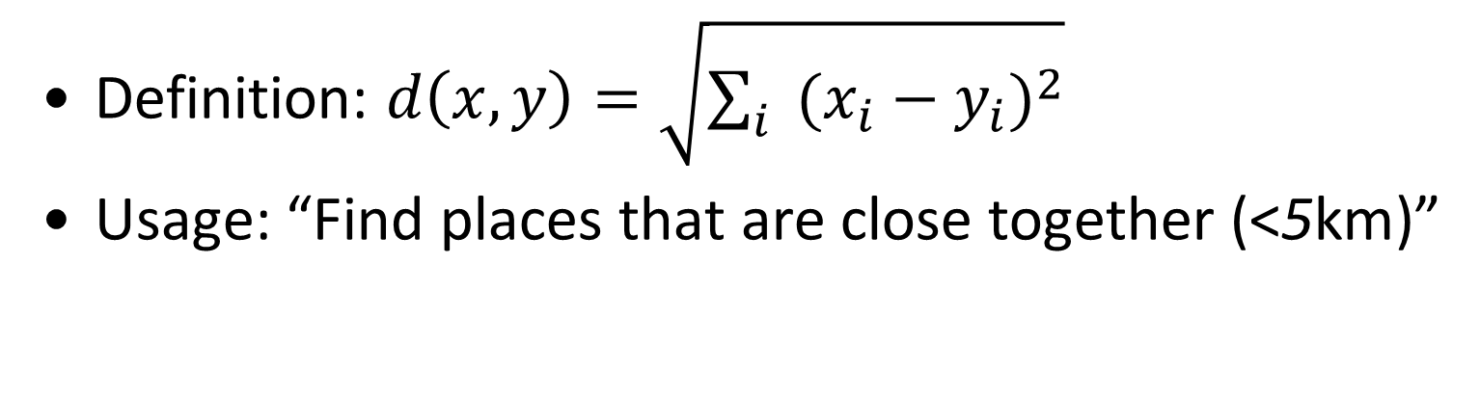
Euclidian Distance
Definition: $d\left(x, y\right)=\sqrt{\sum_{i}{{(x_{i}−y_{i})}^{2}}}$
Usage: “Find places that are close together (<5km)”
y
d(x, y)
x

Slide 67
Approximate Euclidian Distance
Project to random lines v
Partition lines in buckets of size a
h_{v}(x) = bucket containing the projection of x
(a/2, 2a, 1/2, 1/3)-sensitive
y
d(x, y)
h_{v}(y) = 4
h_{v}(x) = 1
x
0
1
2
a
3
a
4
Bucket
v
Notes:
Note that in this case we can not completely control the min/max distance as y >= 4x by the hash function. In reality, we can reduce the distance and use arbitrary x, y (x < y), but we will not know the actual p, q values, only there exist some valid values p, q for the given x, y, if x < y <= 4x.

Slide 68
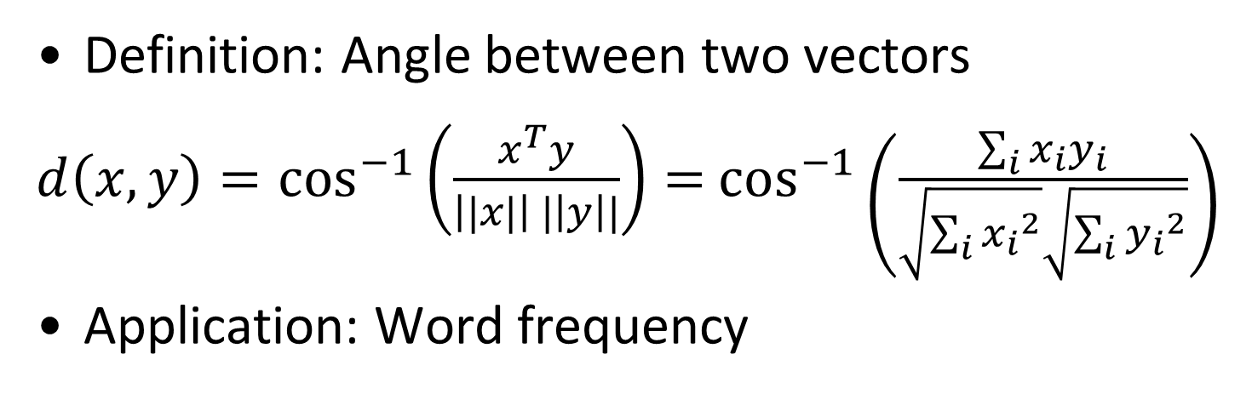
Cosine Distance
Definition: Angle between two vectors
$d\left(x, y\right)=\cos^{−1}\left(\frac{x^{T}y}{\left||x|\right| |\left|y\right||}\right)=$ $\cos^{−1}\left(\frac{\sum_{i}{x_{i}y_{i}}}{\sqrt{\sum_{i}{{x_{i}}^{2}}}\sqrt{\sum_{i}{{y_{i}}^{2}}}}\right)$
Application: Word frequency
y
d(x, y)
x

Slide 69
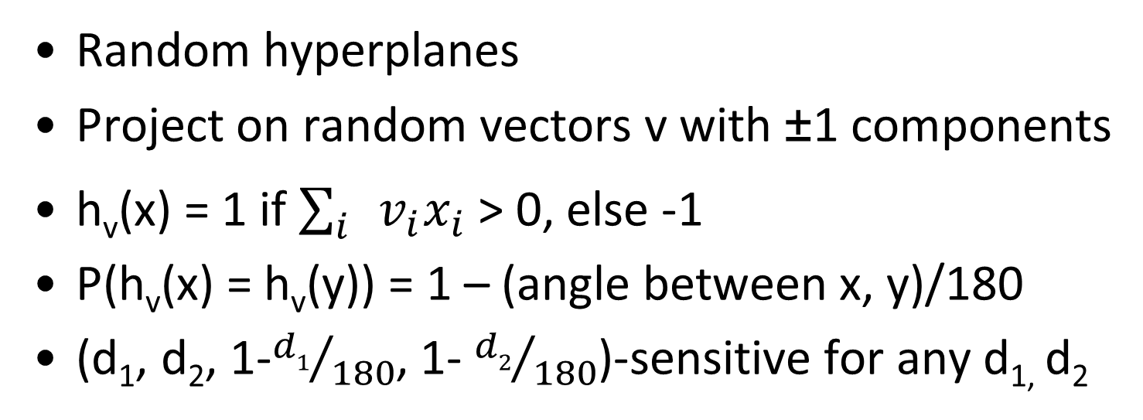
Approximate Cosine Distance
Random hyperplanes
Project on random vectors v with ±1 components
h_{v}(x) = 1 if $\sum_{i}{v_{i}x_{i}}$ > 0, else -1
P(h_{v}(x) = h_{v}(y)) = 1 – (angle between x, y)/180
(d₁, d₂, 1-${d1}/{180}$, 1- ${d2}/{180}$)-sensitive for any d_{1,} d₂
y
v
h_{v}(y) = 1
h_{v}(x) = -1
d(x, y)
Hyperplane
defined in 2D by v
x
Notes:
Hyperplane: divide the space into two equal parts (with a dividing hyperplane passing through the origin). The resulting hash value is +1 if the hashed vector is on the first half of the space and -1 if it’s on the other one.

Slide 70
Random hyperplanes: join cardinality
Assume only two sets and allow duplicates (multiset)
4-wise independent vector elements v_{i}
E[v_{i} v_{j} v_{k}v_{l} ] = 0, if i, j, k, l all different
P(v_{i}=-1) = P(v_{i}=+1) = 0.5
If an element exists multiple times, multiply with corresponding v_{i} the same number of times as it exists
COUNT(R S) can be estimated by h_{v}(R) h_{v}(S)
Notes:
For more see: minos slides

Slide 71
Conclusions
Query-specific summarizations
Compress data using LSH functions
AND/OR constructs to change LSH guarantees
Notes:
Query specific summarizations allow for compressing the data efficiently by exploiting properties of the queries we try to answer.
LSH functions provide accuracy guarantees for detecting very similar and very dissimilar items and these functions can be used to compress data while allowing us to answer threshold-based similarity queries.
AND-/OR- constructs allow us to generate new families for LSH functions with different probabilistic guarantees at the expense of using more hashing functions.

Slide 72
Readings in LSH
http://infolab.stanford.edu/~ullman/mining/2009/similarity3.pdf
http://infolab.stanford.edu/~ullman/mining/2009/similarity2.pdf
http://infolab.stanford.edu/~ullman/mining/2009/similarity1.pdf
http://infolab.stanford.edu/~ullman/mining/2006/lectureslides/cs345-lsh.pdf
M. Datar, N. Immorlica, P. Indyk, V. S. Mirrokni. Locality-sensitive hashing scheme based on p-stable distributions. SCG ‘04
http://infolab.stanford.edu/~ullman/mmds/ch3.pdf
A.Z. Broder, M. Charikar, A.M. Frieze, M. Mitzenmacher, “Min-wise independent permutations,” ACM Symposium on Theory of Computing

